Slide 1
Final Learnings - Intro to Software Engineering
By Jeffrey Simonoff

Slide 2
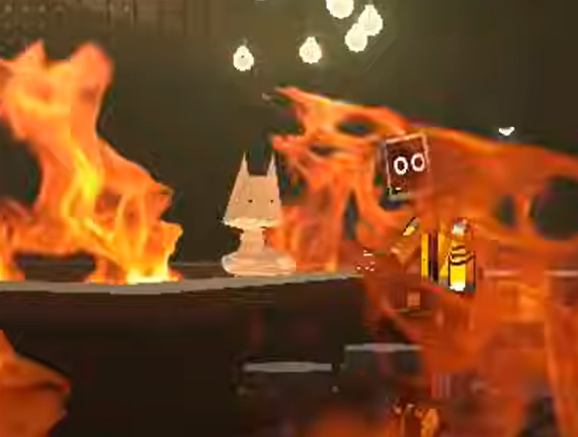
Introduction
What I learned
Agile Framework
Scrum Teams
Client-Server Relationships
HTTP functions
Version Control
MVT
Customer Requirements
Databases
Bootstrap and Stylization
Testing
How it affects my work

Slide 3
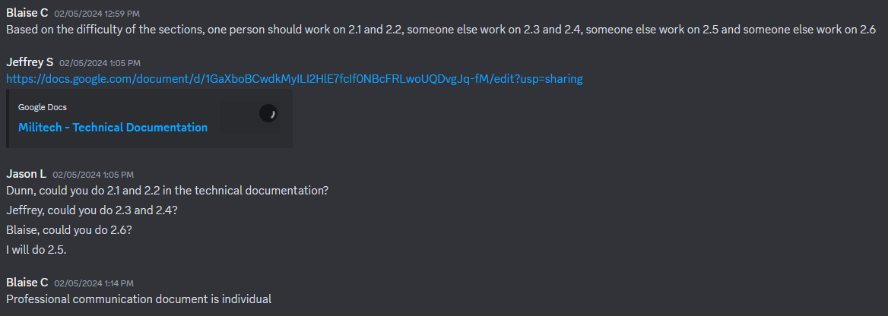
Agile Framework and Scrum Teams
Agile Framework
Work with the stakeholder often for requirements, testing, and updating.
Make progress through increments with updates and new features, rather than progressing with one version.
Scrum Coach
The scrum coach’s main priority is to direct the scrum team. In short, the scrum coach coaches the team on what to do.
As the scrum coach, it is their role to keep sprint projects moving at all times by keeping members on task. Additionally, the scrum coach arranges meeting times, recordings, and agendas, as well as provide feedback to other members of the team.
Note: The scrum coach is not responsible for getting each member of the team to their goal; the scrum coach is a guide for the team.
My experience as a scrum coach could have been handled better. I managed to
Technical Lead
The technical lead is responsible for technical troubleshootings for the scrum team, as well as leading the team through technical documentation. The technical lead is expected to start projects earlier than their other team members, allowing for more ease in troubleshooting.
Note: The technical lead is not responsible for solving every problem the team may face, as well as having every member complete their sections in technical documents.
Team Member
A team member of a scrum team may assist in creating a technical document, as well as troubleshooting issues the team may face, but unlike the scrum coach and technical lead, they are assistants. Like all members of a scrum team, the team member must participate in synchronous and asynchronous meetings.
They are not required to help other members of the team complete their work.

Slide 4
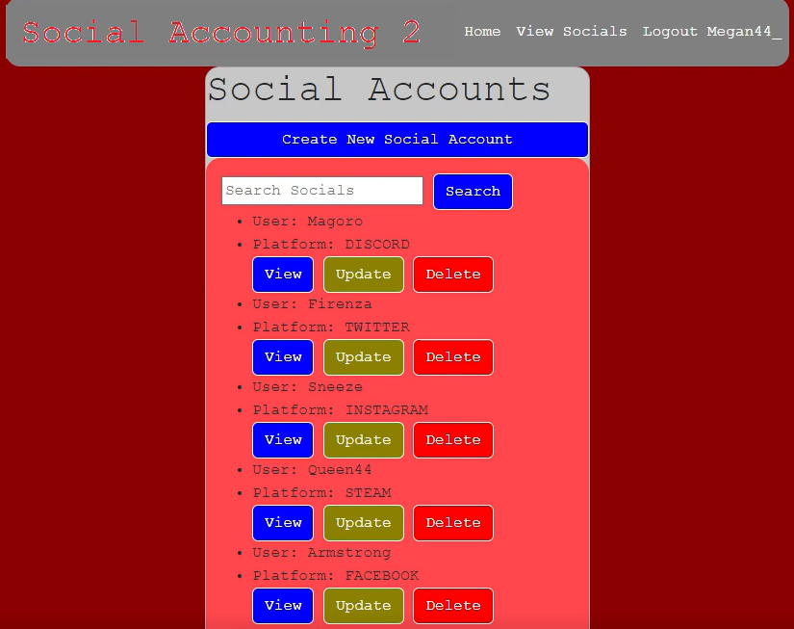
Software as a Service(SaaS)
Software as a Service is a type of service that uses cloud computing to create a single version of a piece of software to update overtime. These changes work in tandem with agile development, where requirements and new features are received from interactions with the client.
It’s programmed in segments rather than in one session.
New features and updates are added.
The data of the software is not lost due to being stored on the cloud.
The software is accessible over the web.
The server provider manages all of the features of the application.
I managed to create a web application that services social media users, displaying a list of accounts with associated platforms and other information.

Slide 5
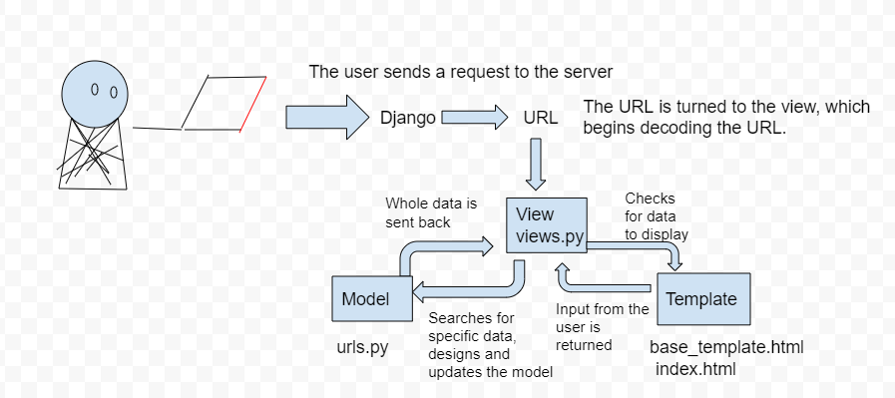
Client-Server Relationship
How it works
A client sends a request to the server.
The server responds to the request made by the client.
Advantages
A Client-Server protects the uploaded data through its centralized architecture.
Being on the same system is not required as the uploaded data resides in the cloud.
Disadvantages
Can be overloaded
A Denial of Service can occur if too many users access the same data at the same time.
I used Django and Git Bash for my application, which uses a Client Server relationship to retrieve required information. I requested my homepage in this example, and the information provided is the server fulfilling my request.

Slide 6
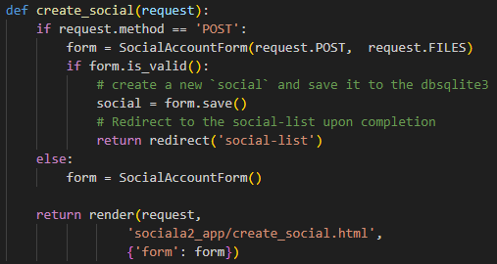
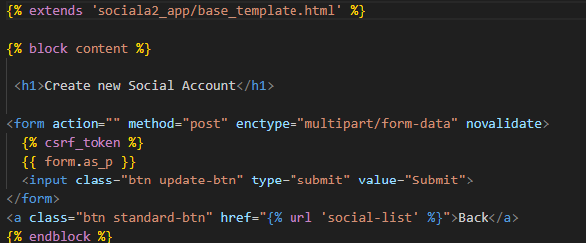
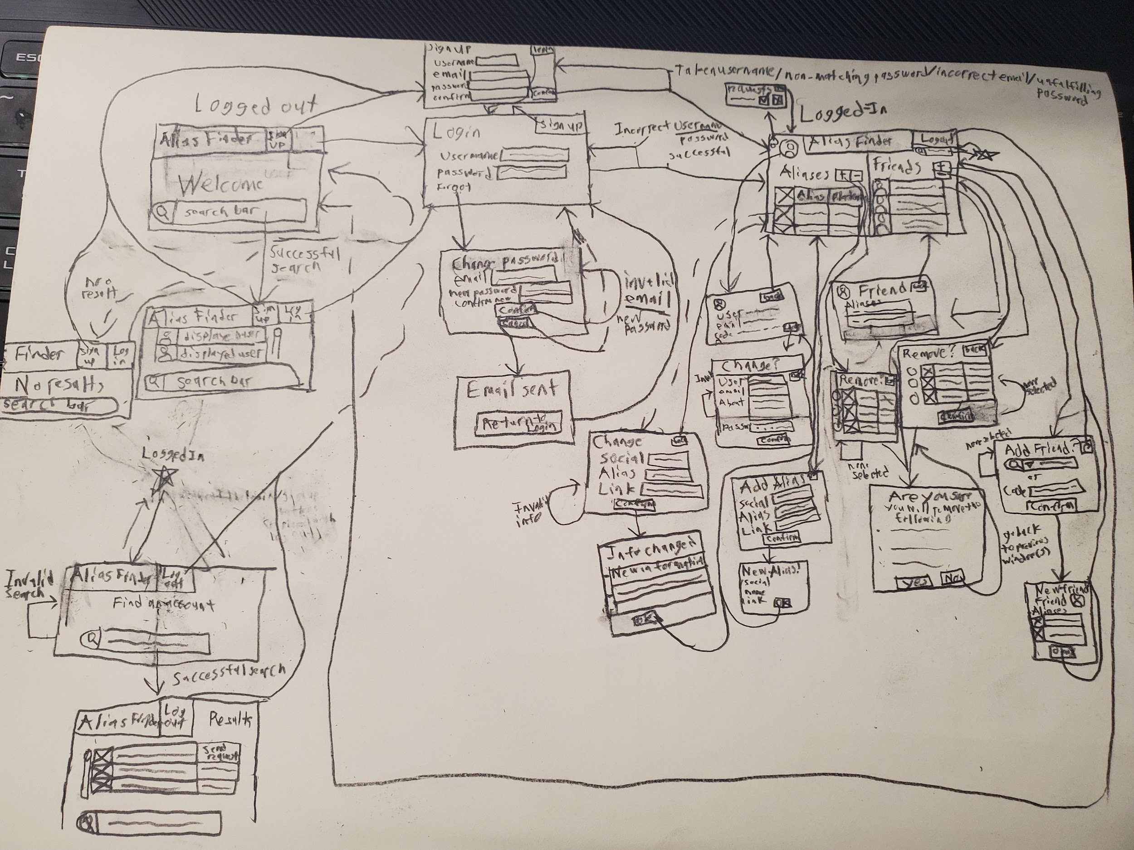
MVT(Models, Views, Templates)
The following examples below show a model for my social accounts application, as well as a view demonstrating the functionality of creating a new social account to add to the list, where a template formats the social list page. The lo-fi mockup sketch, made by me, details my initially planned functionality for my application.
Models
Models act as the general interface for a web application, and it acts as the structure behind the application through logic, represented with a database.
The model typically uses the class attribute in Object-Relational Mapping
Models control the following:
Access
Validation
Data Relationships
Views
Views handle the application’s logic and functionality.
The view acts as a bridge between templates and models.
In Object-Relational Mapping, the views use function attributes, as well as the occasional class attribute.
Templates
Templates show how the data is displayed from the model via a structure created in HTML files.
A template uses inheritance, html structure, tags, and variables in Object-Relational Mapping.
Lo-Fi Sketches
A Lo-Fi sketch shows the functionality of the application. This acts as a rough draft for how the application may look and function, often including details from the provided MVT.

Slide 7
Version Control
Safety Measures
Separate versions are contained
Improper changes can be undone
All code and changes are saved
More than one software version
Version control allows the user to test new features and updates with different versions, allowing the user to visit an older version if the updated version experiences certain errors.
Usage of Branches
Branches are used to separate versions in Git
Branches are usually short-lived due to testing different versions of a program. If that version has been successful, it will be merged to create one version of the software.
Examples: Sprint01 & Sprint02
Merging
Take a new version of the software and fuse the functionality with the old software.
For version control, I used three separate branches to create my project: main, sprint01, and sprint02.

Slide 8
Customer Requirements
Gathering Information
When it comes to developing a web application for a client, a list of required features should be gathered to determine what the application will do. These requirements are gathered through interviews, which are then converted to User Stories and BDD Scenarios.
User Stories
A user story outlines the overall purpose of an application, detailing the end user’s narrative and acceptance criteria. They’re written in non-technical language, and are written in the perspective of the end-user.
As a…
I want…
So that…
BDD(Behavior Driven Development) Scenarios
BDD scenarios outline planned individual functions and features of the application.
BDD scenarios use a Happy and Sad Path, where the sad path is the function working, but the desired result is not achieved, and the happy path is that desired result being achieved. The sad path is not a lack of a function or error.
If…
Then…
When…
(optional)But…, And…
The shown examples showcase the base requirements of creating my social account application, as well as the search function for when the user is logged out.

Slide 9
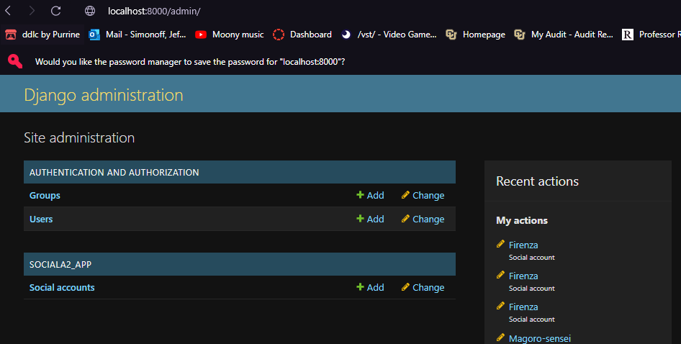
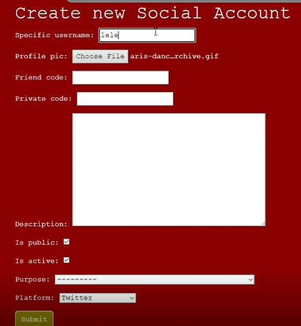
Databases
Admin Control
Databases can be managed by the admin of the application through the admin site. This admin is defined as a superuser, and can be responsible for assigning roles to other users, preventing unwanted access to certain areas of the application, as well as create new objects from pre-existing models.
Usage of Models
When a database is created, it usually follows the structure of a model, which can use the following parameters. These models are further implemented with forms, which assign the model fields to the application functionality itself.
Text Fields
Character Fields
Image Fields
Boolean Fields
Foreign Key and One-To-One Fields
I created a database to format the creation of the items in my social accounts application, and I used admin control to assign two different roles to users. These roles are follower and influencer, where the influencer can create, update, and delete social accounts, which the follower cannot do.

Slide 10
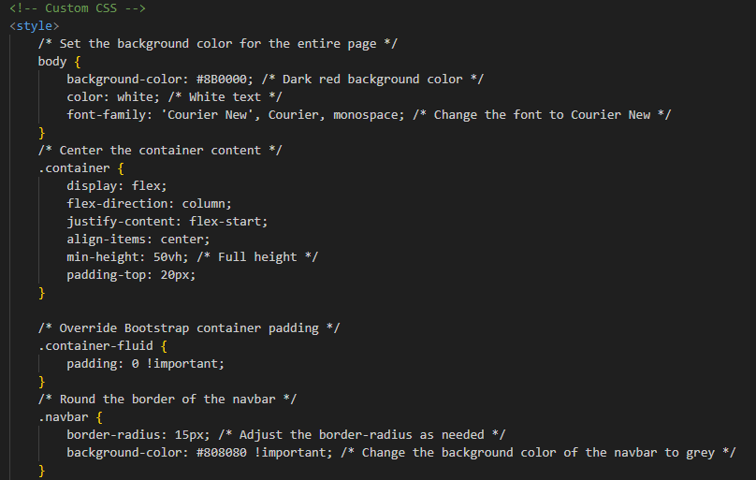
Bootstrap and Stylization with HTML templates
Bootstrap
Bootstrap is a software framework that is primarily used for the features used to style an application. These style features are implemented through an html template.
HTML
HTML is a type of coding software used in web design, and uses a variety of features to format a model. These features include:
Headers
Hyperlinks
Buttons
Search Bars
Lists
Cards
Containers
Images
Etc.
I used stylization to change the formatting of images uploaded to my social accounts application. Additionally, I used background colors and the border radius feature to round the border of the navigation bar, as well as change the background color to grey.

Slide 11
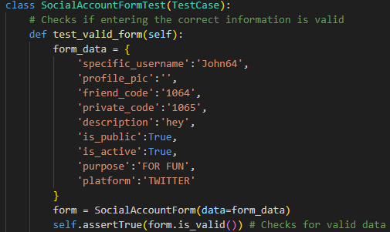
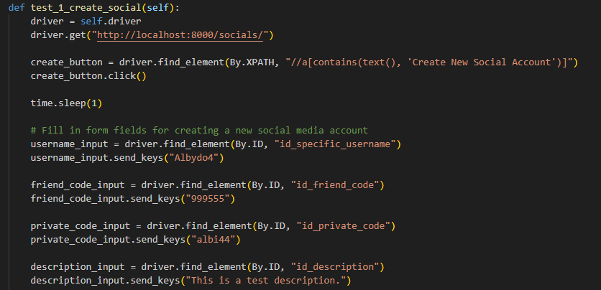
Testing
TDD
Test Driven Development is an iterative methodology that focuses on testing the software, where each stage of development and scenario is accounted for with both automated and manual testing. The primary goal of TDD is to improve the application’s overall design, as well as reduce costs, improve development, and prevent bugs.
Testing and the cycle
During testing, development follows a specific cycle, where the developer starts with no code, then a feature is implemented, where tests are made for that feature. If that test fails, it will be rewritten to pass, and then refactoring occurs. This cycle continues until all features are accounted for, and all possible test scenarios have been written.
Testing can be automated with Unit Tests, which test the models, views, and templates, as well as Selenium Tests, which runs a browser to test the overall functionality of the application.
The following examples show my unit test for testing a valid SocialAccount form, as well as a selenium test detailing the creation of a social account in the application.

Slide 12
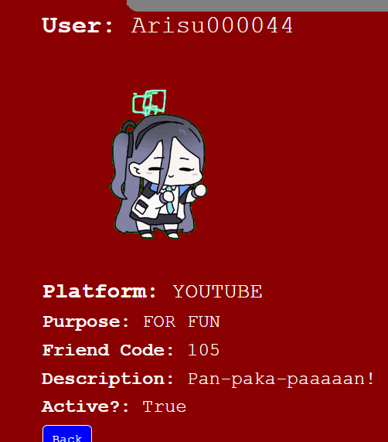
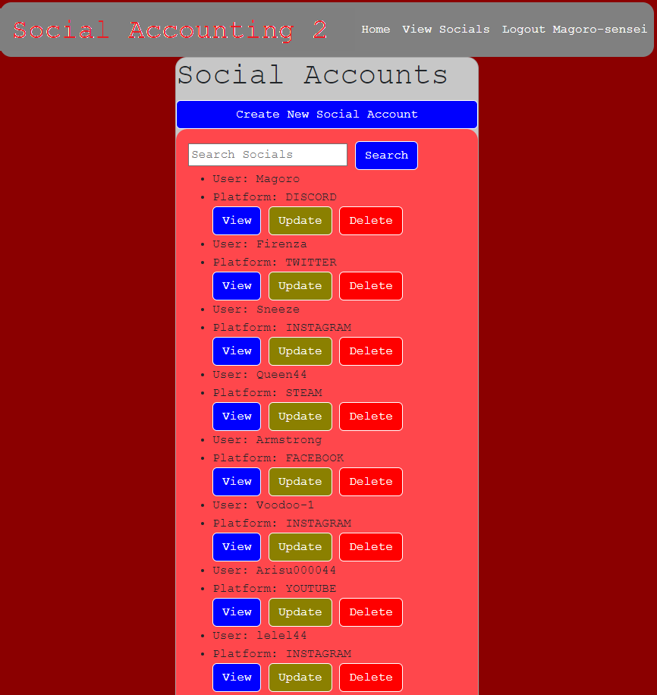
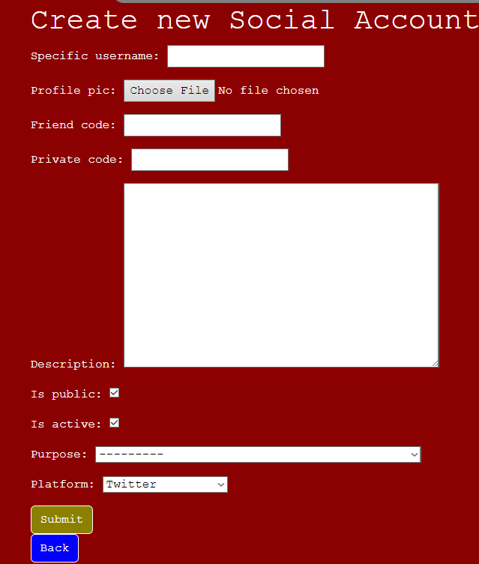
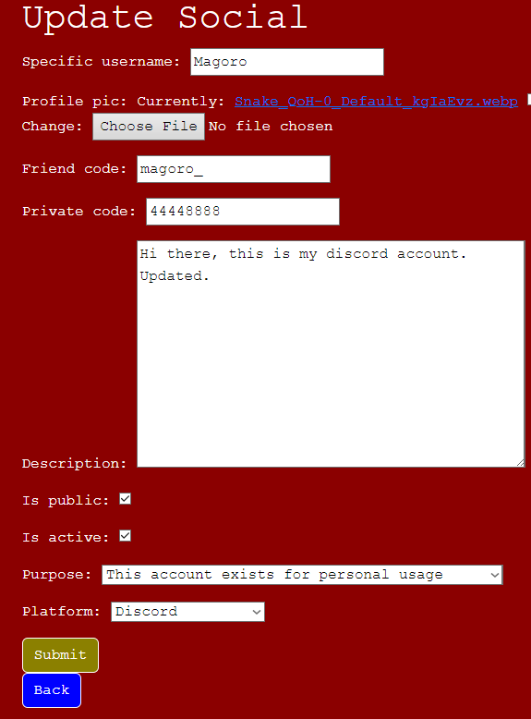
Final Result
Home page Social List Social Details
Create page
Update page
Delete page

Slide 13
Resources
https://www.techtarget.com/searchnetworking/definition/client-server#:~:text=Client-server%20is%20a%20relationship,computing%20model%20used%20by%20mainframes.
https://www.wallarm.com/what/what-is-saas
https://www.clearlyagile.com/agile-blog/what-a-scrum-coach-can-do-for-organizations#:~:text=A%20Scrum%20Coach%20focuses%20on,the%20Agile%20Manifesto%20was%20signed. https://angelogentileiii.medium.com/basics-of-django-model-view-template-mvt-architecture-8585aecffbf6.
https://www.atlassian.com/git/tutorials/what-is-version-control#:~:text=Version%20control%2C%20also%20known%20as,to%20source%20code%20over%20time.
https://blog.ifs.com/2022/12/behavior-driven-development-bdd-approach-for-user-story-writing/.
https://www.w3schools.com/django/django_add_bootstrap5.php.
https://www.spiceworks.com/tech/devops/articles/what-is-tdd/#:~:text=Test-driven%20development%20(TDD)%20is%20defined%20as%20an%20iterative,and%20tracking%20the%20component%20repeatedly.
https://cucumber.io/blog/bdd/intro-to-bdd-and-tdd/.

Slide 14
Thank You!

